Slide 1

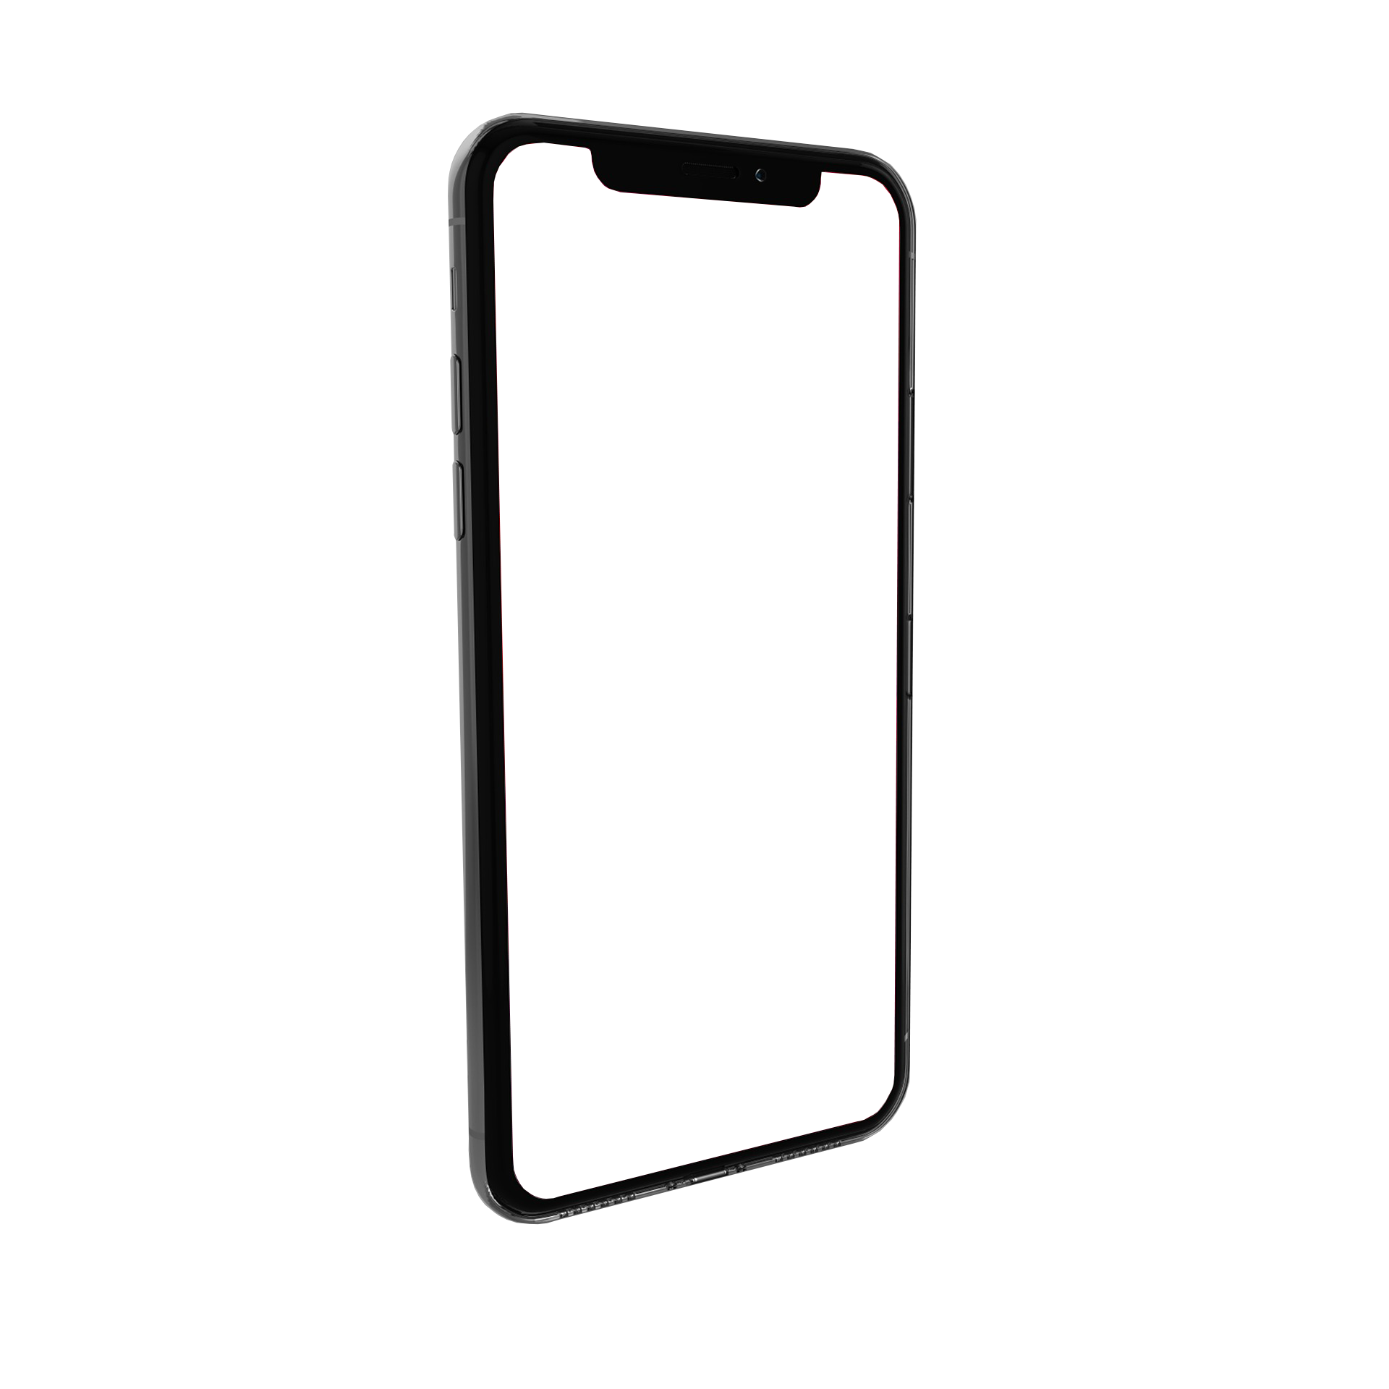

VigyBag
An Online Location based Shopping Solution
[ Vivek Kumar, Founder and CEO of “ VigyBag” ]

Slide 2
Problem Statement
Today's consumers want convenience and efficiency when shopping.
Traditional online shopping can be time-consuming and frustrating.
Brick-and-mortar stores can be inconvenient and may not carry the products consumers want.
Our solution: A location-based shopping website that offers convenience, efficiency, and personalized recommendations to make shopping easy and enjoyable.

Slide 3
Solution
Our website uses geolocation technology to find nearby stores and products.
Consumers can browse and purchase items from multiple stores in one place.
Our personalized recommendation system suggests products based on previous purchases and browsing history.
Our website also offers deals and discounts from partner stores.

Slide 4
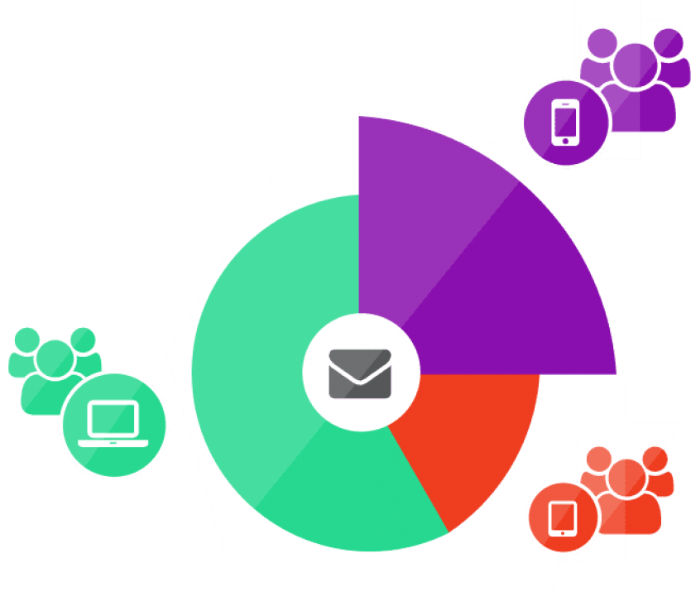
Agenda
Urban and suburban consumers who want convenience and a personalized shopping experience.
People who are busy and don't have time to visit multiple stores.
Shoppers who value quality and variety in their products.
Age group: any age.

Slide 5
Market Opportunity
According to Statista, the e-commerce market in India is projected to grow to $200 billion by 2027.
Our website can capture a significant share of this market by offering a unique and convenient shopping experience.
Our website also offers opportunities for partnerships with local stores and businesses.

Slide 6

Revenue Model
Our revenue model is based on a commission-based system with partner stores.
We will also offer paid premium memberships for additional benefits and discounts.
We project revenue of 20,000 rupees in the first year and 1,00,1000 rupees in the second year.

Slide 7
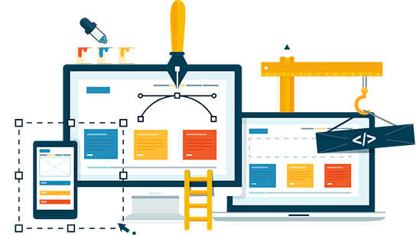
Development Timeline
Our website development will take 3 months.
Our website launch is planned for July,2023.
Our App development will take 2 to 3 months so that our user also connect through app.
We will continue to improve and update the website based on user feedback and market trends.

Slide 8
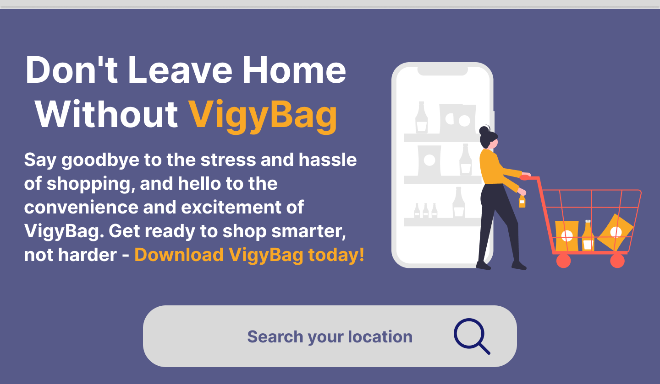
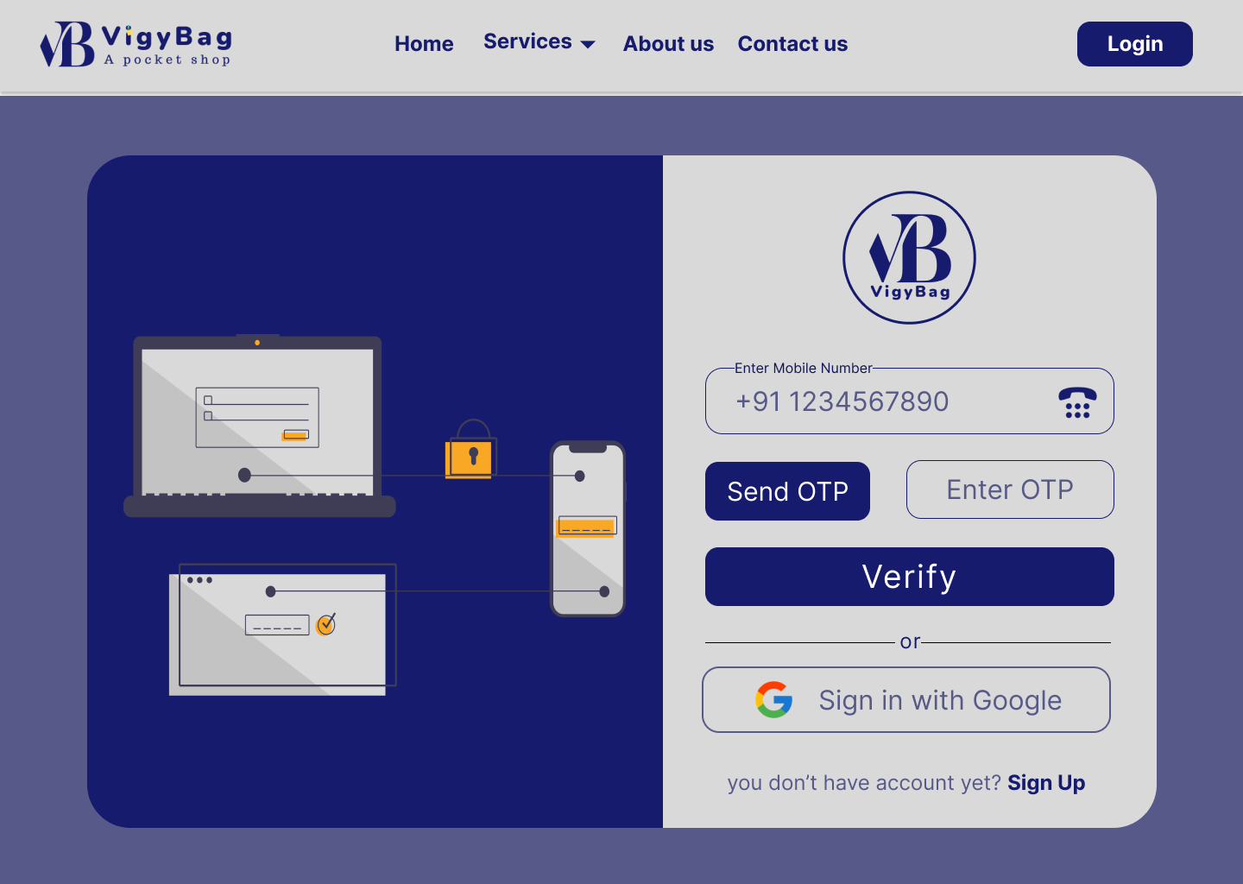
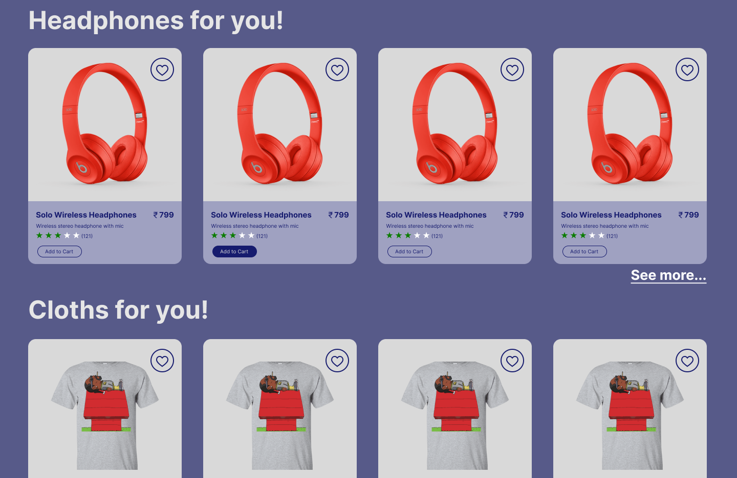
Sample Work
This is the sample design and development. We will develop this website with the help of AI. So that it can show the relevant product to the user.

Slide 9

Team
At this time I am only person in our team
I am finding team members who is experienced and passionate with their work.
Definitely I will add team member when I will find someone good to work with me.

Slide 10

Funding Needs
We are seeking 20,000 rupees in funding for website development, App development marketing, and initial operations.
We are open to partnerships and investments from interested parties.

Slide 11
THANK YOU

